Slide 1
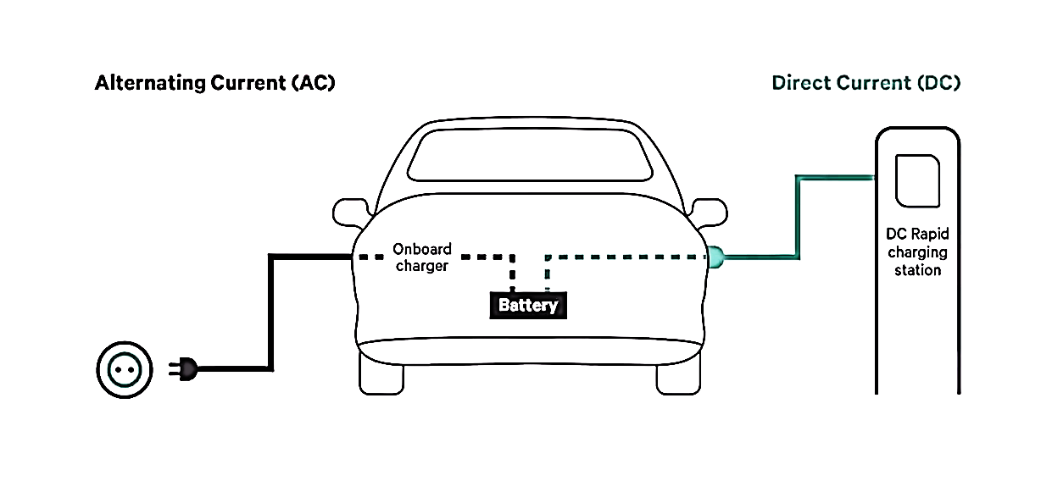
Types of EV Charging: Conductive

Slide 2
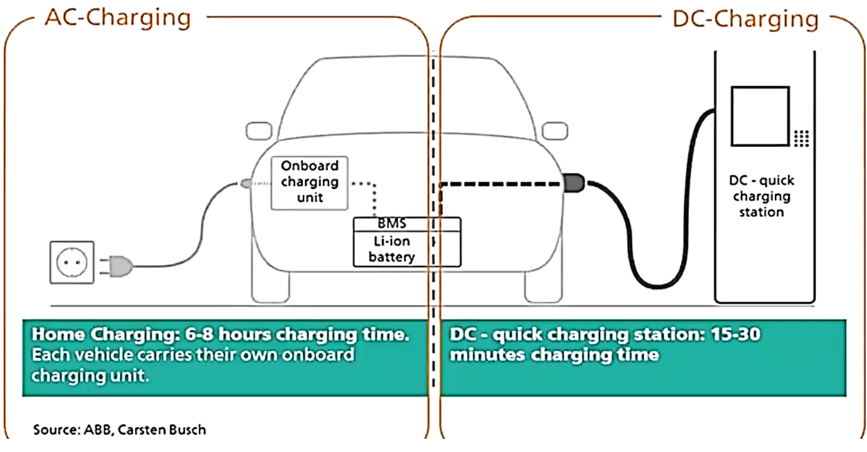

Slide 3
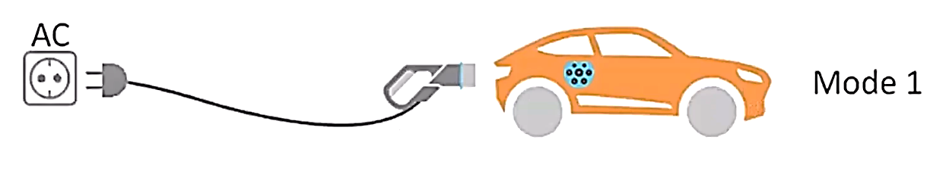
EV Charging modes
Mode 1
This mode entails slow AC charging via a regular electrical socket. This is no communication between the vehicle and the charging point. It is required to provide an earth wire to the EV and have an external means of protection against faults. In many countries,
this form of charging is considered to be unsafe and is illegal.

Slide 4
EV Charging Methods
Conductive Charging
Inductive Charging
Battery Swapping

Slide 5
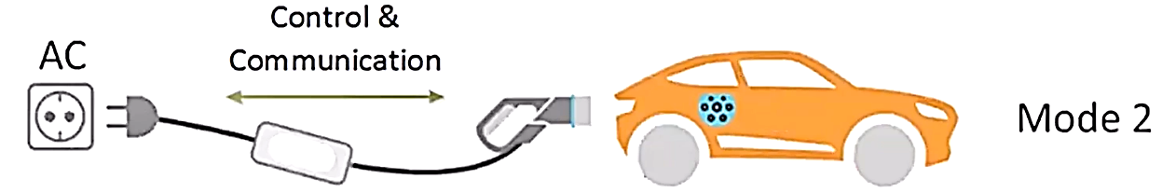
Mode 2
This mode provides for slow AC charging from a regular electricity socket. In addition, the charging cable is equipped with an In-Cable Control and Protection Device (IC-CPD), that is responsible for control, communication and protection (including residual
current protection).

Slide 6
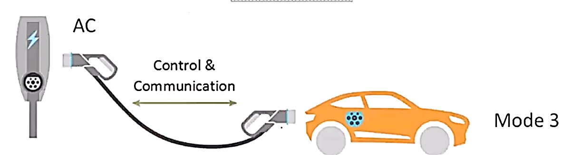
Mode 3
This mode entails both slow or semi-fast charging via a dedicated electrical socket for EV charging. The charger (or the charging station) has an EV specific socket, generally corresponding to Type 1 or Type 2. A charging cable with an EV plug on both sides is used to connect the EV to the charger. The charging station is responsible for the control, communication and protection of the charging process
(including residual current protection). This mode is commonly used for public charging stations and can facilitate integration with smart grids.

Slide 7
EVSE Power Ratings
 | Power level | Current type | Compatible EV segments
Normal power charging | P < 7KW | AC & DC | E-2Ws, e-3Ws, e-cars,other LCVs (up to 1 ton)
 | 7KW < P < 22KW | AC & DC
High power Charging | 22KW < P < 50KW | DC | E-Cars, LCVs and MCVs (1-6 Tons)
 | 50KW < P < 200KW | DC

